Slide 1
The Principle of Relatedness Local & Global Knowledge Sourcing Pierre-Alexandre Balland

Slide 2
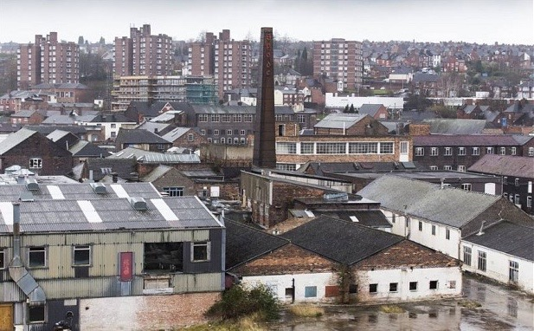

Slide 3
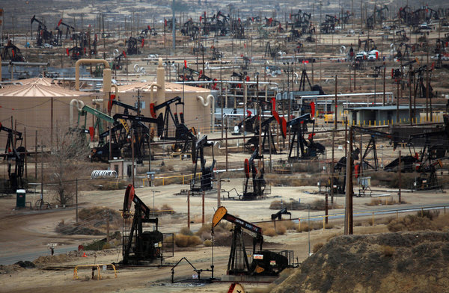

Slide 4
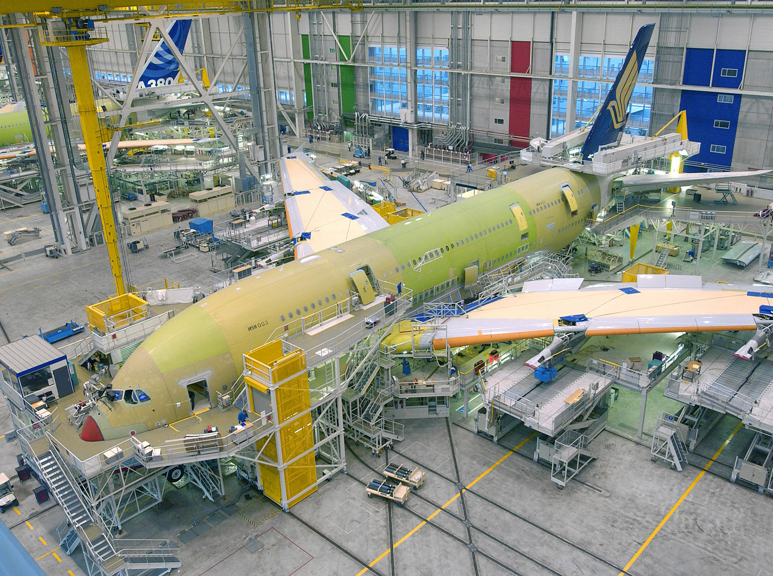

Slide 5
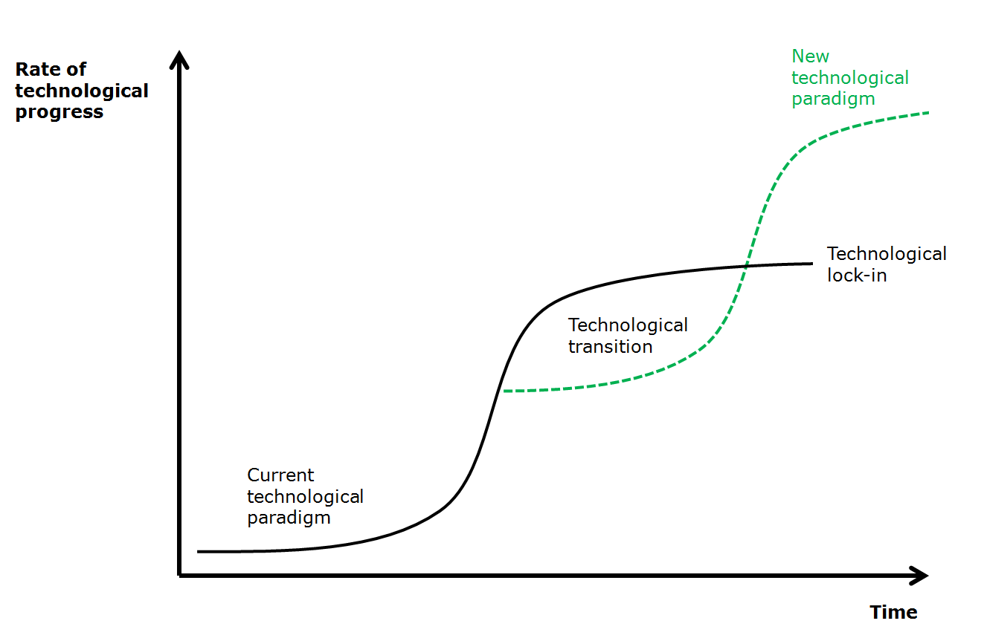

Slide 6
Key issues
Regions need to continuously re-invent themselves to secure long run prosperity

Slide 7
Key issues
Regions need to continuously re-invent themselves to secure long run prosperity
Identify diversification opportunities that upgrade the regional economy

Slide 8
Key issues
Regions need to continuously re-invent themselves to secure long run prosperity
Identify diversification opportunities that upgrade the regional economy
By building on local capabilities (internal relatedness)

Slide 9
Key issues
Regions need to continuously re-invent themselves to secure long run prosperity
Identify diversification opportunities that upgrade the regional economy
By building on local capabilities (internal relatedness)
By connecting to regions that have complementary capabilities (external relatedness)

Slide 10
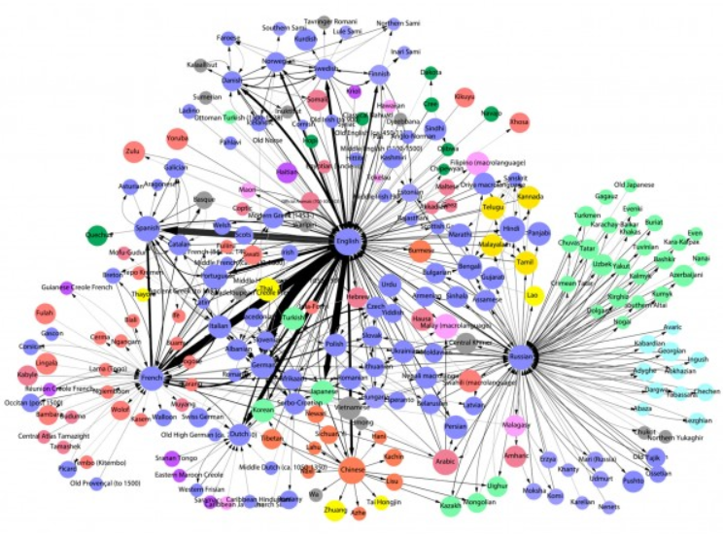
Most influential languages

Slide 11
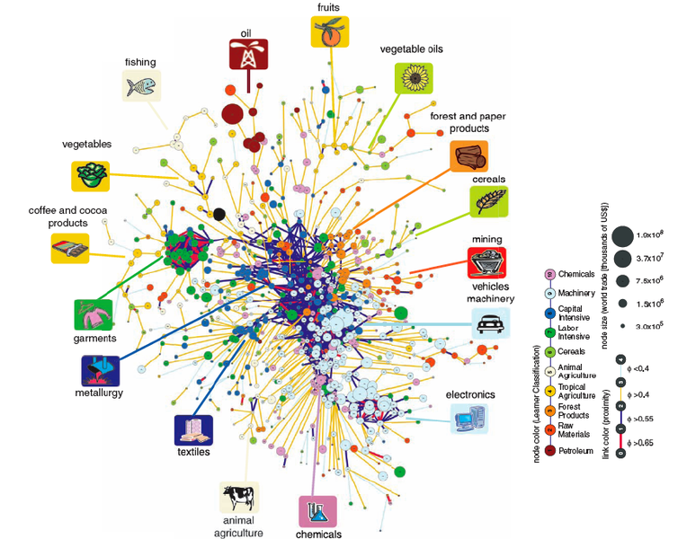
The product space

Slide 12
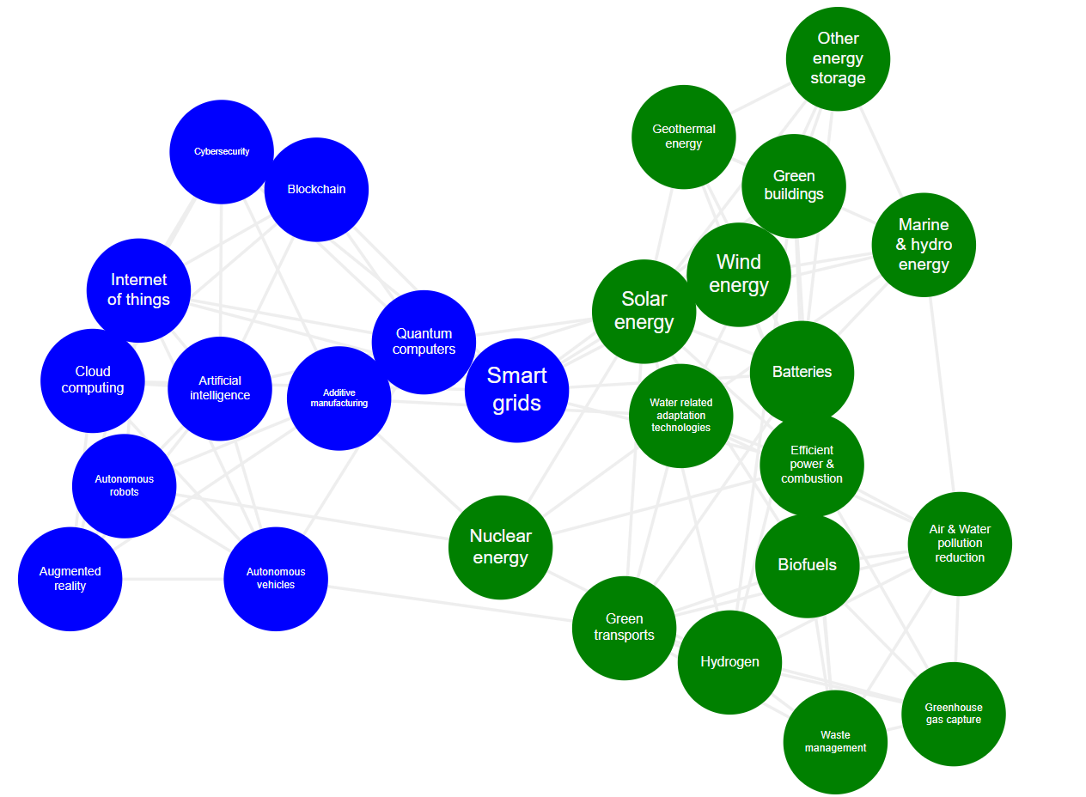
The technology space

Slide 13
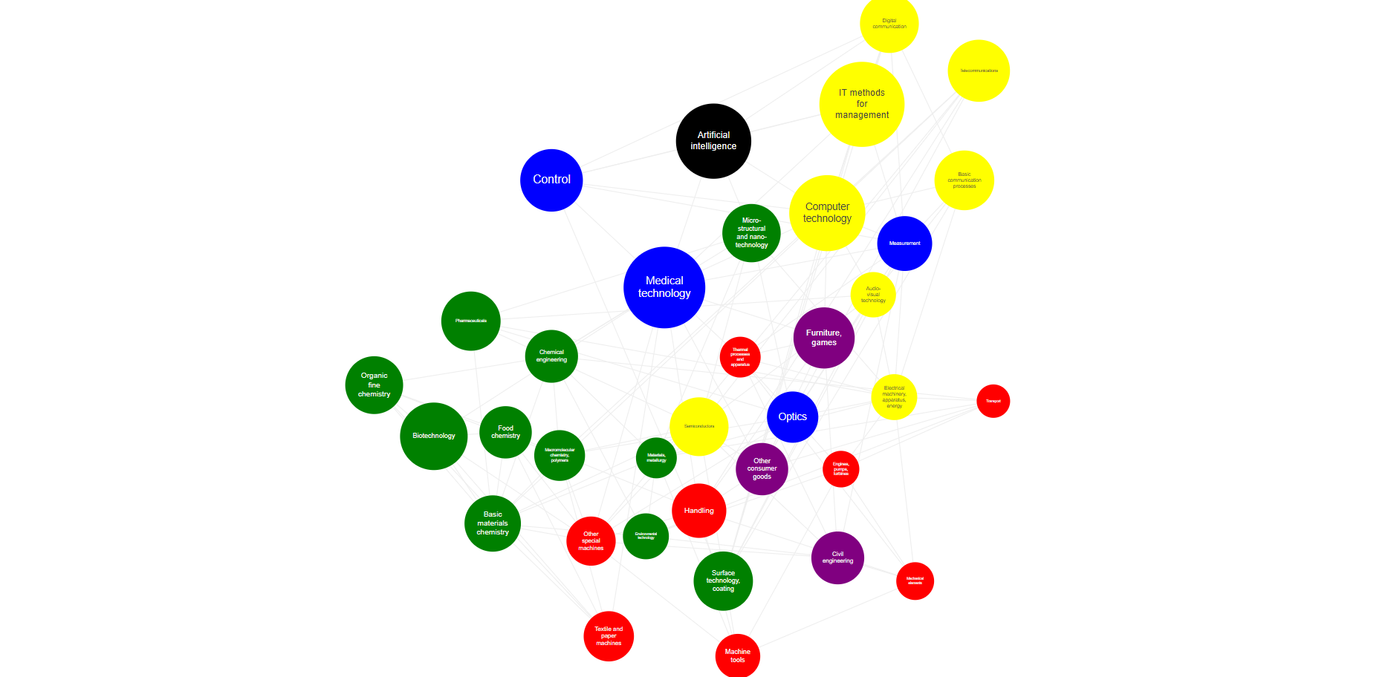
US knowledge space prior to the AI revolution
Balland, P.A. (2021)
Report for DG Grow

Slide 14
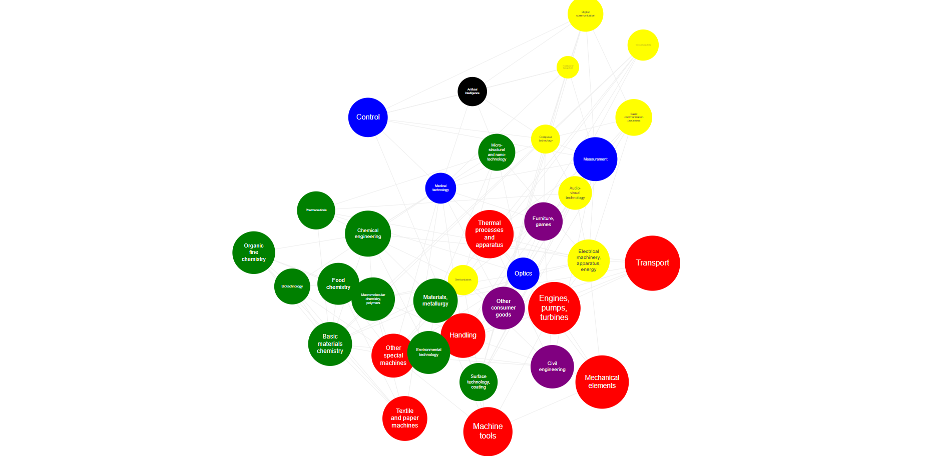
EU knowledge space prior to the AI revolution
Balland, P.A. (2021)
Report for DG Grow

Slide 15
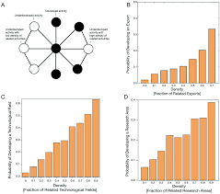
The principle of relatedness
The structure of the economy allows to predict its further evolution
Hidalgo, C., Balland, P.A., Boschma, R., Delgado, M., Feldman, M., Frenken, K., Glaeser, E., He, C., Kogler, D., Morrison, A., Neffke, F., Rigby, D., Stern, S., Zheng, S., and Zhu, S. (2018) The Principle of Relatedness, Unifying Themes in Complex Systems (IX): 451-457

Slide 16
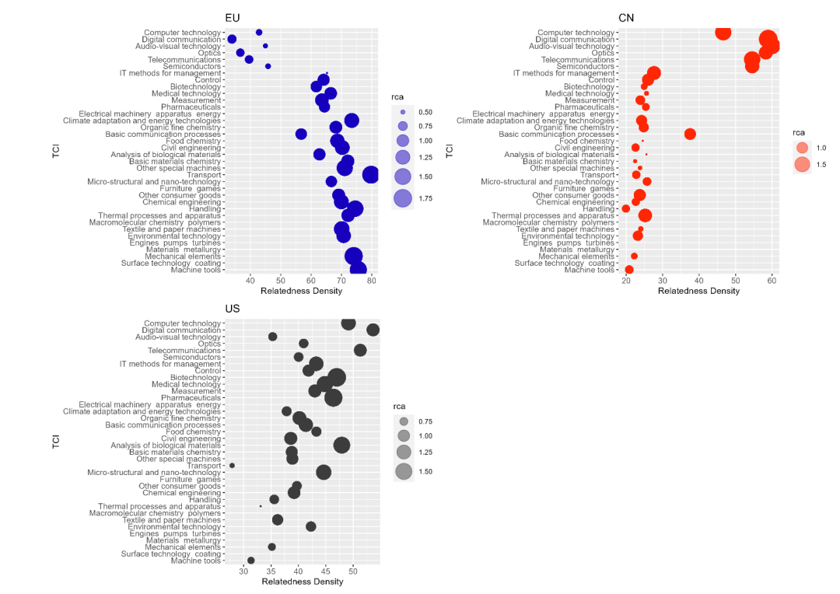
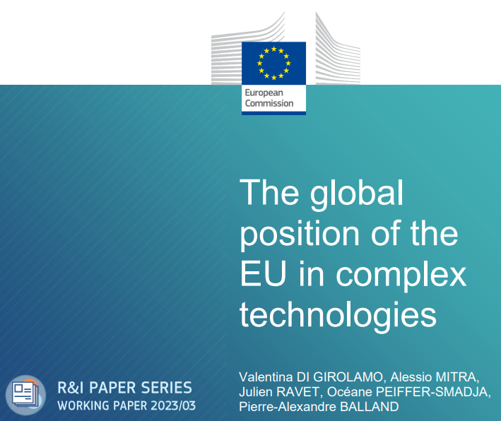

Slide 17
The density of related technologies
City | Technology | Density (%)
Ile de France | Biotech | 10
Ile de France | Nanotech | 100
Rhone Alpes | Biotech | 80
Rhone Alpes | Nanotech | 0
… | … | …
The Density Index indicates how close a potential new technology is to the knowledge bases of a given city

Slide 18
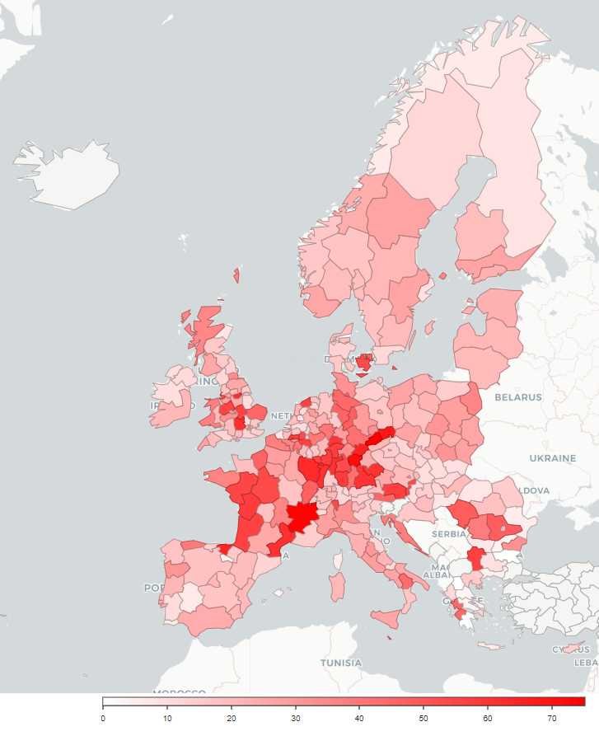
European hubs in battery technologies

Slide 19

Video 1
Video 2
We build recommendation systems to guide investment decisions in cities
Cust. 1
Cust. 2

Slide 20
Tech 1
Tech 2
We build recommendation systems to guide investment decisions in cities
City 1
City 2

Slide 21
Evidence-based framework for S3
Complexity
Nanotech
Biotech
Relatedness
Balland, P. A., Boschma, R., Crespo, J., & Rigby, D. L. (2019). Smart specialization policy in the European Union: relatedness, knowledge complexity and regional diversification. Regional Studies, 53(9), 1252-1268.

Slide 22
Smart Investment Framework
Complexity
High Risks
High Benefits
Low Risks
High Benefits
High Risks
Low Benefits
Low Risks
Low Benefits
Relatedness
Balland, P.A., Boschma, R., Crespo, J. and Rigby, D. (2019) Smart Specialization policy in the EU: Relatedness, Knowledge Complexity and Regional Diversification, Regional Studies, 53 (9): 1252-1268

Slide 23
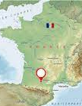
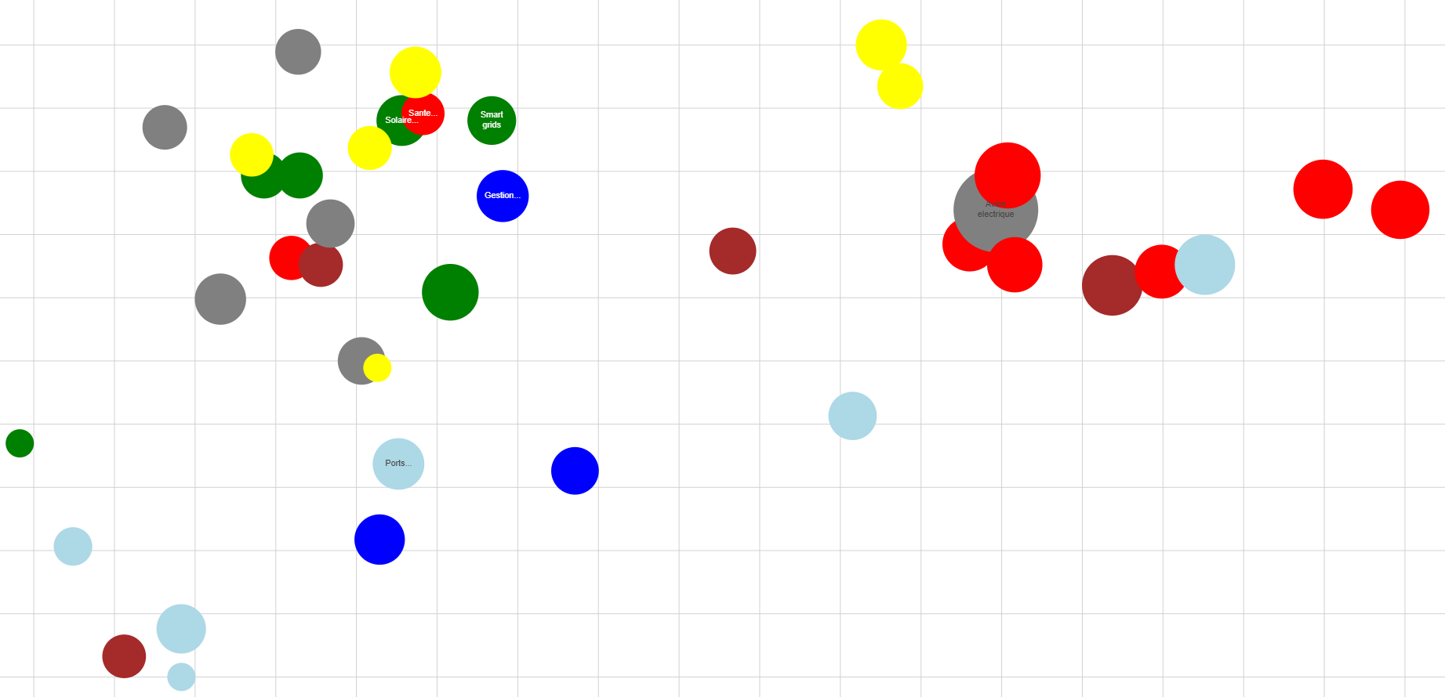

The case of the Toulouse region
Embedded Systems
Complexity
Batteries
Oncology
Smart grids
Composites materials
Electrical plane
Biotherapies
Protein of the future
Off-shore wind turbines
Geosciences
Relatedness

Slide 24
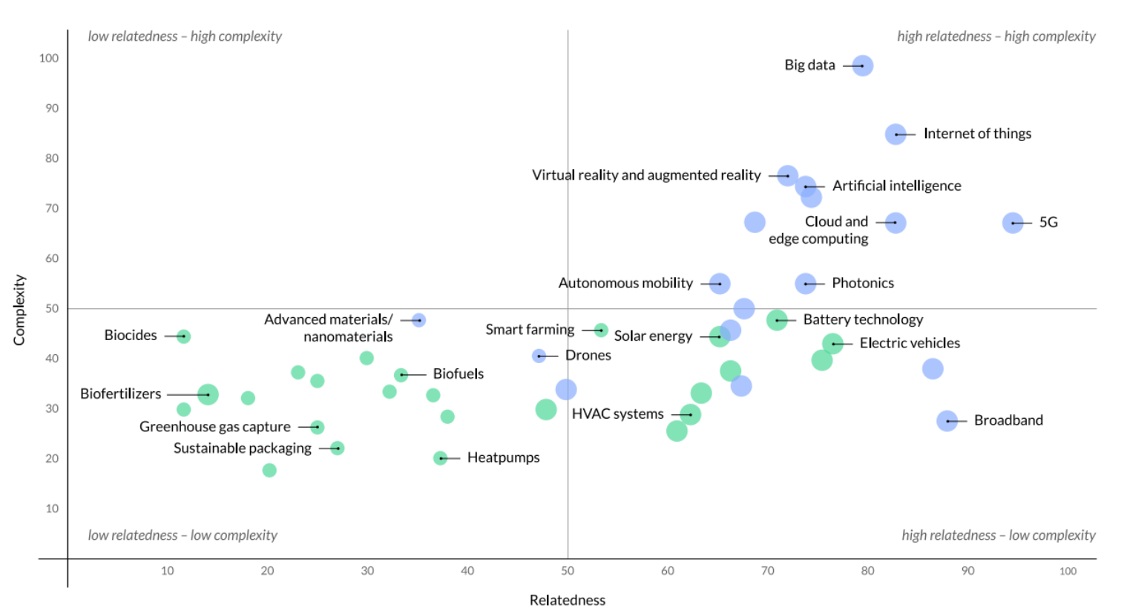

Slide 25
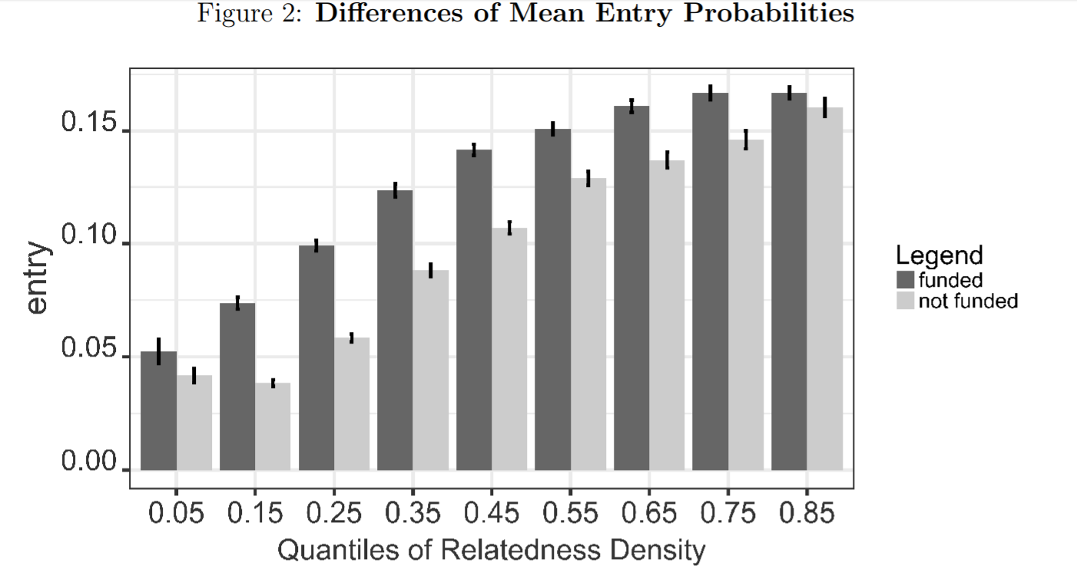
Uhlbach, W., Balland, P.A. & Scherngell, T. (2022); Industry and Innovation, 29 (4): 511-532.

Slide 26
Beyond local capabilities
Local capabilities are key but so are external linkages
Balland and Boschma (2019) show that regions that collaborate with complementary regions more likely to develop successful specializations
A key issue to identify the right regions as strategic partners as part of S3
Strategic partners not just any regions but the ones that can provide missing capabilities

Slide 27
How to find strategic partners?
Added Relatedness
Technology i
Region C
(+ 50%)
Region B
(+ 30%)
Distance

